Slide 1
Statistics for IT
Normal Distribution

Slide 2

Continuous Random Variables
A random variable is continuous if it can assume the infinitely many values corresponding to points on a line interval.
Examples:
Heights, weights
length of life of a particular product
experimental laboratory error

Slide 3
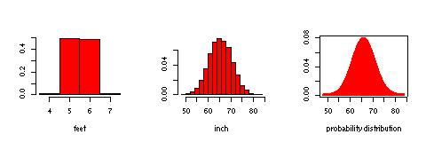
Continuous Probability Distribution
Suppose we measure height of students in this class. If we “discretize” by rounding to the nearest feet, the discrete probability histogram is shown on the left. Now if height is measured to the nearest inch, a possible probability histogram is shown in the middle. We get more bins and much smoother appearance. Imagine we continue in this way to measure height more and more finely, the resulting probability histograms approach a smooth curve shown on the right.

Slide 4
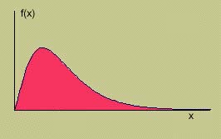
Probability Distribution for a Continuous Random Variable
Probability distribution describes how the probabilities are distributed over all possible values. A probability distribution for a continuous random variable x is specified by a mathematical function denoted by f(x) which is called the density function. The graph of a density function is a smooth curve.

Slide 5
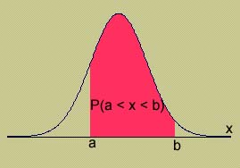
Properties of Continuous Probability Distributions
f(x) ≥ 0
The area under the curve is equal to 1.
P(a ≤ x ≤ b) = area under the curve between a and b.

Slide 6
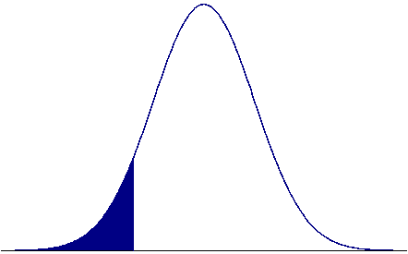
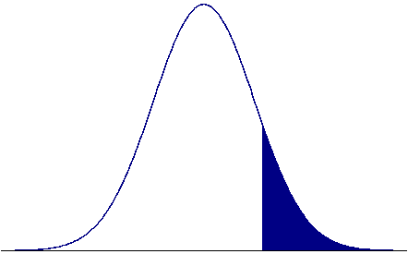
Some Illustrations
a
b
P(x<a)
P(x>b)
Notice that for a continuous random variable x,
P(x = a) = 0
for any specific value a because the “area above a point” under the curve is a line segment and hence has 0 area. Specifically this means
P(x<a) = P(x ≤ a)
P(a<x<b) = P(a≤x<b) = P(a<x≤b) = P(a ≤x≤b)

Slide 7
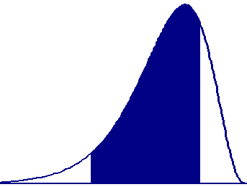
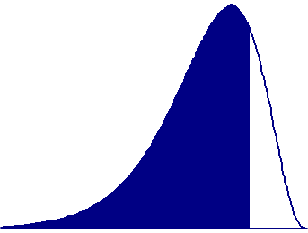
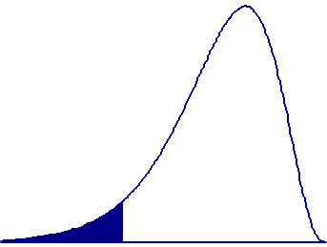
Method of Probability Calculation
The probability that a continuous random variable x lies between a lower limit a and an upper limit b is
P(a<x<b) = (cumulative area to the left of b) –
(cumulative area to the left of a)
= P(x < b) – P(x < a)
=
-
a
b
b
a

Slide 8
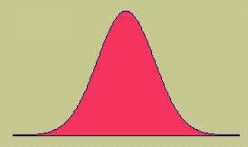
Continuous Probability Distributions
There are many different types of continuous random variables
We try to pick a model that
Fits the data well
Allows us to make the best possible inferences using the data.
One important continuous random variable is the normal random variable.

Slide 9
The Normal Distribution
The formula that generates the normal probability distribution is:
Two parameters, mean and standard deviation, completely determine the Normal distribution. The shape and location of the normal curve changes as the mean and standard deviation change.

Slide 11
Normal Distributions: μ=0

Slide 12
The Standard Normal Distribution
To find P(a < x < b), we need to find the area under the appropriate normal curve.
To simplify the tabulation of these areas, we standardize each value of x by expressing it as a z-score, the number of standard deviations σ it lies from the mean μ.

Slide 13
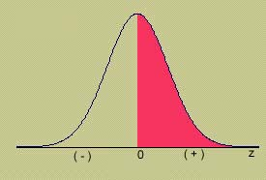
The Standard Normal (z) Distribution
Mean = 0; Standard deviation = 1
When x = μ, z = 0
Symmetric about z = 0
Values of z to the left of center are negative
Values of z to the right of center are positive
Total area under the curve is 1.
Areas on both sides of center equal .5

Slide 14
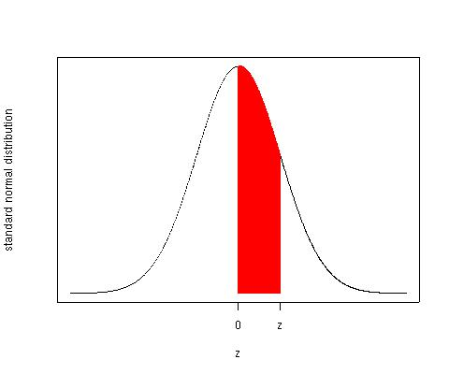
Using Table 3
The four digit probability in a particular row and column of Table 3 gives the area under the standard normal curve between 0 and a positive value z. This is enough because the standard normal curve is symmetric.

Slide 15
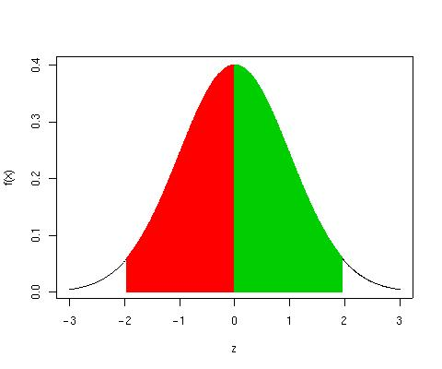
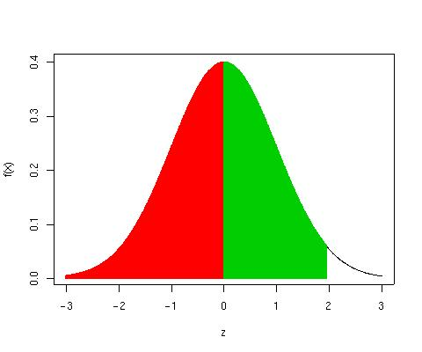
Using Table 3
To find an area between 0 and a positive z-value, read directly from the table
Use properties of standard normal curve and other probability rules to find other areas
P(0<z<1.96) = .4750
P(-1.96<z<0)= P(0<z<1.96)=.4750
P(z<1.96)=P(z<0)+ P(0<z<1.96)=.5+.4750=.9750
P(z<-1.96)=P(z>1.96)=.5-.4750=.0250
P(-1.96<z<1.96)=P(z<1.96)-P(z<-1.96)
=.9750-.0250=.9500

Slide 16
Working Backwards
Often we know the area and want to find the z-value that gives the area.
Example: Find the value of a positive z that has area .4750 between 0 and z.
Look for the four digit area closest to .4750 in Table 3.
What row and column does this value correspond to?
3. z = 1.96

Slide 17
Example
P(z<?) = .75
P(z<?)=P(z<0)+P(0<z<?)=.5+P(0<z<?)=.75
P(0<z<?)=.25
z = .67
What percentile does this value represent?
75th percentile, or the third quartile.

Slide 18
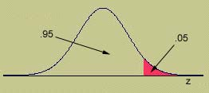
Working Backwards
Find the value of z that has area .05 to its right.
The area to its left will be 1 - .05 = .95
The area to its left and right to 0 will be .95-.5=.45
Look for the four digit area closest to .4500 in Table 3.
Since the value .4500 is halfway between .4495 and .4505, we choose z halfway between 1.64 and 1.65. z=1.645

Slide 19
Finding Probabilities for the General Normal Random Variable
To find an area for a normal random variable x with mean μ and standard deviation σ, standardize or rescale the interval in terms of z.
Find the appropriate area using Table 3.
Example: x has a normal distribution with mean = 5 and sd = 2. Find P(x > 7).

Slide 20
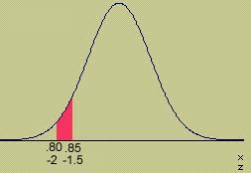
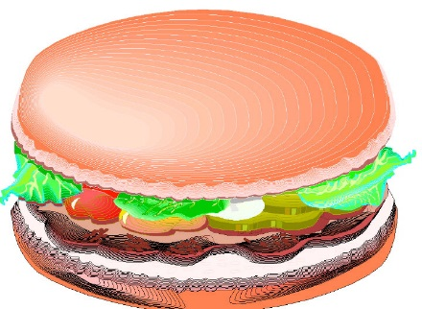
Example
The weights of packages of ground beef are normally distributed with mean 1 pound and standard deviation .10. What is the probability that a randomly selected package weighs between 0.80 and 0.85 pounds?

Slide 21
Example
What is the weight of a package such that only 5% of all packages exceed this weight?

Slide 22

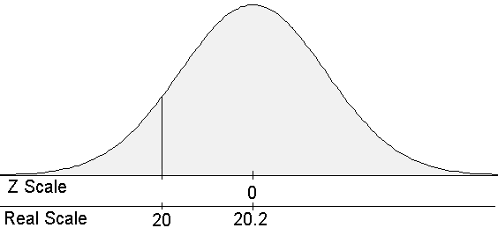
Example
A Company produces “20 ounce” jars of a picante sauce. The true amounts of sauce in the jars of this brand sauce follow a normal distribution.
Suppose the companies “20 ounce” jars follow a normally distribution with a mean μ=20.2 ounces with a standard deviation σ=0.125 ounces.

Slide 23
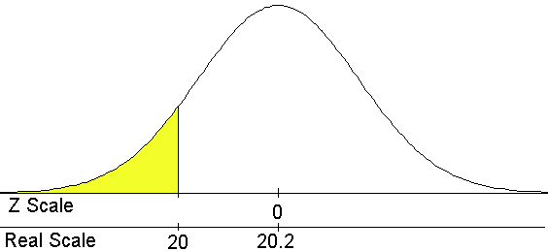
Example
What proportion of the jars are under-filled (i.e., have less than 20 ounces of sauce)?
P(z<-1.60) = P(z>1.60) = P(z>0)-P(0<z<1.60) = .5-.4452 = .0548. The proportion of the sauce jars that are under-filled is .0548

Slide 24
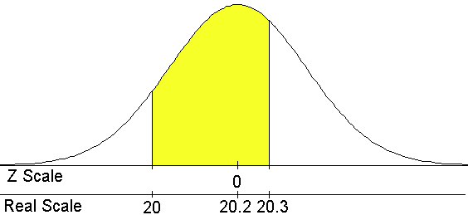
Example
What proportion of the sauce jars contain between 20 and 20.3 ounces of sauce.
P(-1.60<z<.80) = P(-1.60<z<0)+P(0<z<.80) = P(0<z<1.60)+P(0<z<.80)=.4452+.2881=.7333
P(-1.60<z<.80) = P(z<.80)-P(z<-1.60)=.5+P(0<z<.80)-
[.5-P(0<z<1.60)]=P(0<z<1.60)+P(0<z<.80)=.7333

Slide 25
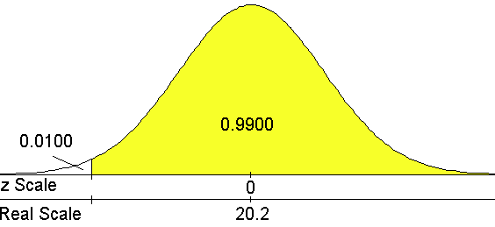
Example
99% of the jars of this brand of picante sauce will contain more than what amount of sauce?

Slide 26
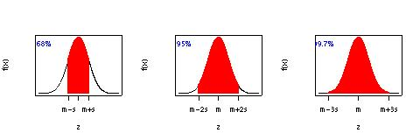
How Probabilities Are Distributed
The interval μ±σ contains approximately 68% of the measurements.
The interval μ±2σ contains approximately 95% of the measurements.
The interval μ±3σ contains approximately 99.7% of the measurements.

Slide 27
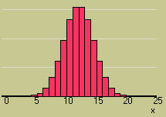
The Normal Approximation to the Binomial
We can calculate binomial probabilities using
The binomial formula
The cumulative binomial tables
When n is large, and p is not too close to zero or one, areas under the normal curve with mean np and variance npq can be used to approximate binomial probabilities.
SticiGui

Slide 28
Approximating the Binomial
Make sure to include the entire rectangle for the values of x in the interval of interest. This is called the continuity correction.
Standardize the values of x using
Make sure that np and nq are both greater than 5 to avoid inaccurate approximations! Or
n is large and μ±2σ falls between 0 and n (book)

Slide 29
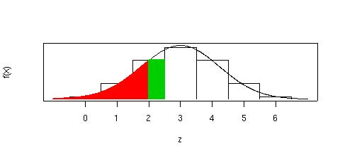
Correction for Continuity
Add or subtract .5 to include the entire rectangle. For illustration, suppose x is a Binomial random variable with n=6, p=.5. We want to compute P(x≤ 2). Using 2 directly will miss the green area. P(x≤ 2)=P(x≤ 2.5) and use 2.5.

Slide 30
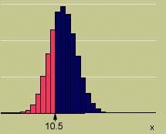
Example
Suppose x is a binomial random variable with n = 30 and p = .4. Using the normal approximation to find P(x ≤ 10).
n = 30 p = .4 q = .6
np = 12 nq = 18
The normal approximation is ok!

Slide 31
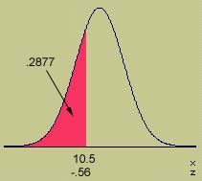
Example

Slide 32
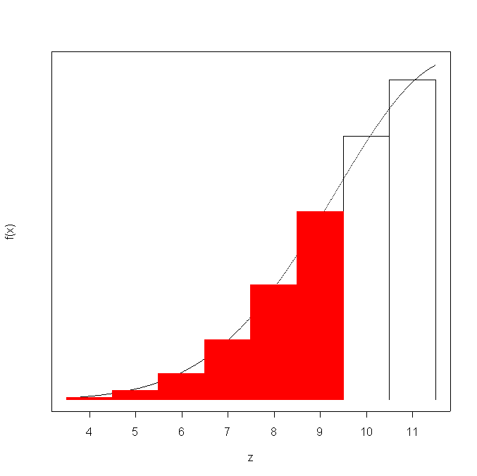
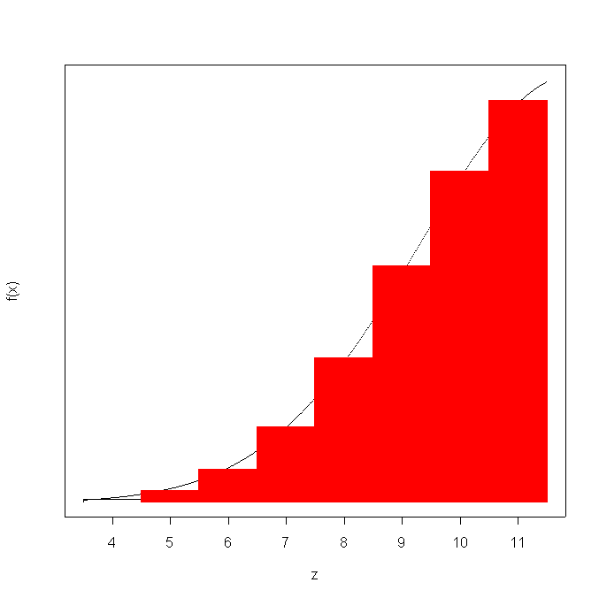
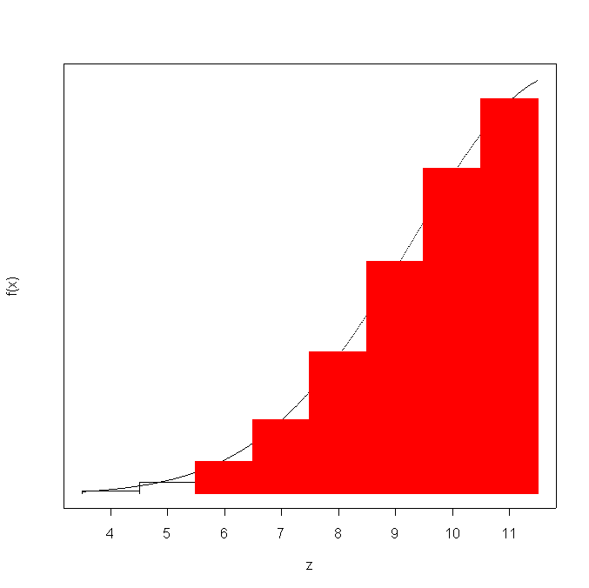


Example

Slide 33

Example
A production line produces AA batteries with a reliability rate of 95%. A sample of n = 200 batteries is selected. Find the probability that at least 195 of the batteries work.
The normal approximation is ok!
Success = working battery n = 200
p = .95 np = 190 nq = 10

Slide 34
Key Concepts
I. Continuous Probability Distributions
1. Continuous random variables
2. Probability distributions or probability density functions
a. Curves are smooth.
b. The area under the curve between a and b represents the probability that x falls between a and b.
c. P (x = a) = 0 for continuous random variables.
II. The Normal Probability Distribution
1. Symmetric about its mean μ .
2. Shape determined by its standard deviation σ .

Slide 35
Key Concepts
III. The Standard Normal Distribution
1. The normal random variable z has mean 0 and standard deviation 1.
2. Any normal random variable x can be transformed to a standard normal random variable using
3. Convert necessary values of x to z.
4. Use Table 3 in Appendix I to compute standard normal probabilities.
5. Several important z-values have tail areas as follows:
Tail Area: .005 .01 .025 .05 .10
z-Value: 2.58 2.33 1.96 1.645 1.28

Slide 36
Thank You!

